Slide 1
Do It!
Think Back!
Joshua 4:1-5:1

Slide 2
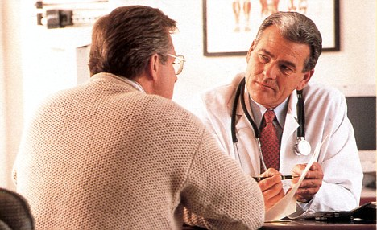
Patient:“Doctor I forget things so easily”
Doctor: “How fast do you forget things?”
Patient:“What? Where am I? Why I’m here?”

Slide 3
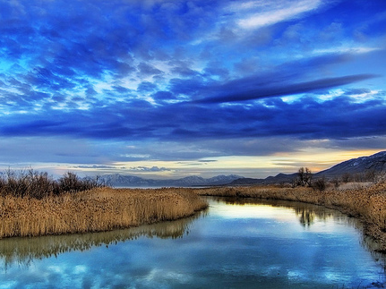

Slide 4
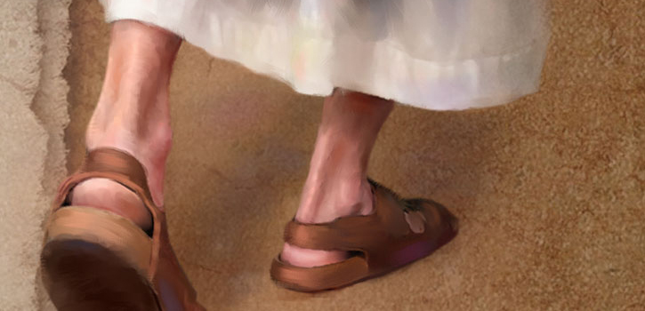
I. Lets be obedient to Him
Joshua 4:1-7

Slide 5
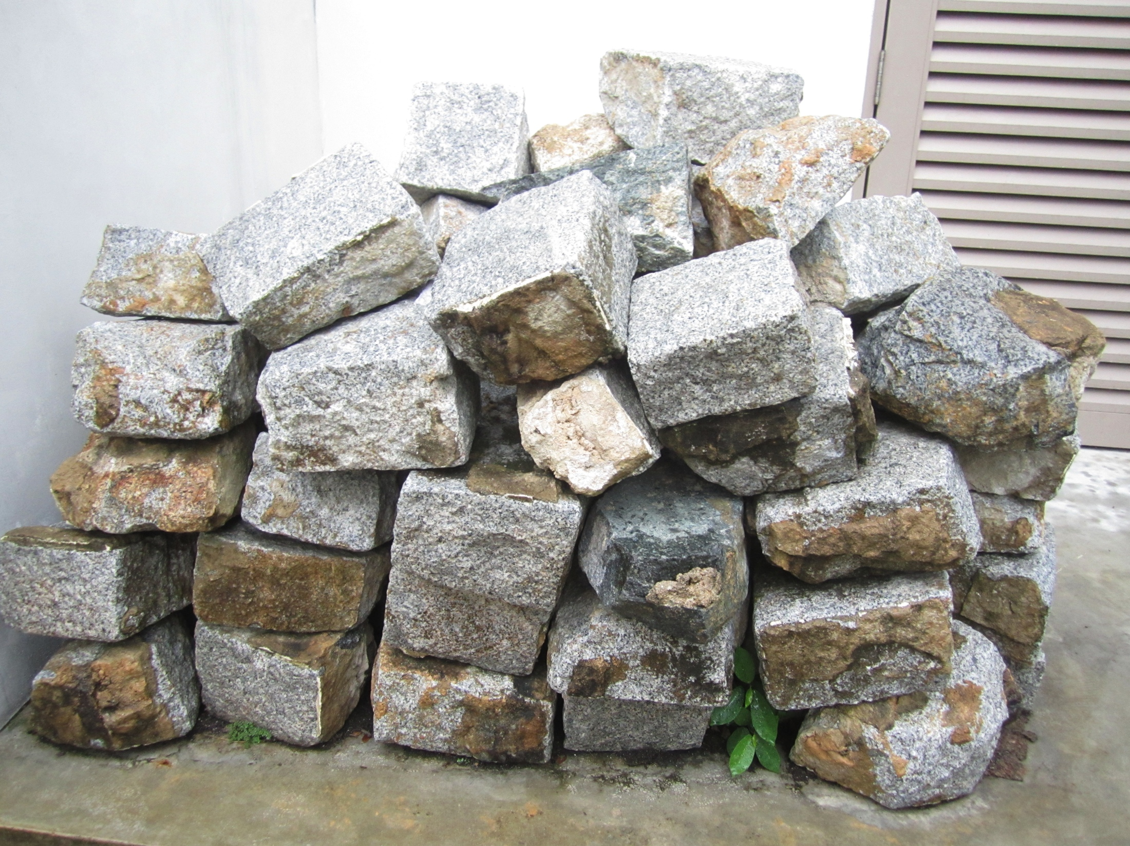

Slide 6
Exodus 24:3-4
When Moses went and told the people all the Lord’s words and laws, they responded with one voice, “Everything the Lord has said we will do.” Moses then wrote down everything the Lord had said. He got up early the next morning and built an altar at the foot of the mountain and set up twelve stone pillars representing the twelve tribes of Israel.

Slide 7
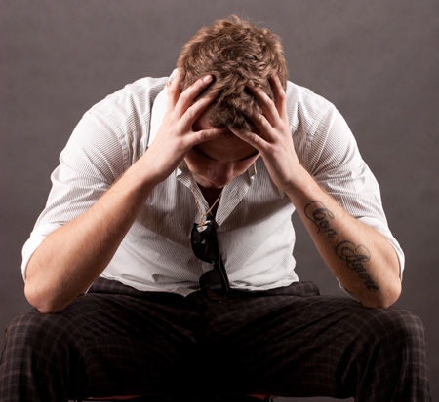
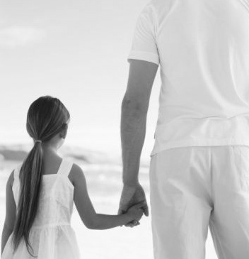
?
?
?
?
Israel served the Lord throughout the lifetime of Joshua and of the elders who outlived him and who had experienced everything the Lord had done for Israel. Joshua 24:31
After that whole generation had been gathered to their ancestors, another generation grew up who knew neither the Lord nor what he had done for Israel. Then the Israelites did evil in the eyes of the Lord and served the Baals. Judges 2:10-11

Slide 8
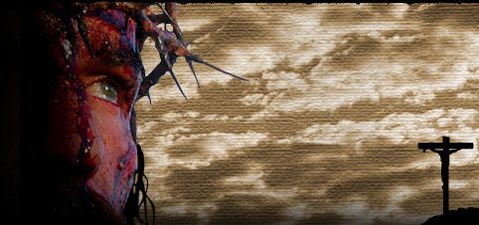
Luke 22:17-19
After taking the cup, he gave thanks and said, “Take this and divide it among you. For I tell you I will not drink again from the fruit of the vine until the kingdom of God comes.” And he took bread, gave thanks and broke it, and gave it to them, saying, “This is my body given for you; do this in remembrance of me.”

Slide 9
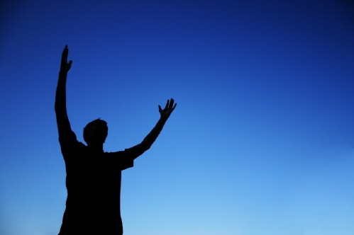
II. Glorify Him among your neighbors
Joshua 4:8-5:1

Slide 10
Joshua 2:9-11
“I know that the Lord has given you this land and that a great fear of you has fallen on us, so that all who live in this country are melting in fear because of you. We have heard how the Lord dried up the water of the Red Sea for you when you came out of Egypt, and what you did to Sihon and Og, the two kings of the Amorites east of the Jordan, whom you completely destroyed. When we heard of it, our hearts melted in fear and everyone’s courage failed because of you, for the Lord your God is God in heaven above and on the earth below.

Slide 11
Joshua 5:1
Now when all the Amorite kings west of the Jordan and all the Canaanite kings along the coast heard how the Lord had dried up the Jordan before the Israelites until they had crossed over, their hearts melted in fear and they no longer had the courage to face the Israelites.

Slide 12
Think back, Do it!
Every day set your time to think what God has done for you and pray for submissive obedience to Him.

